Slide 1

Sales Performance Analysis of Walmart Stores
Using Basic & Advanced MySQL Techniques
Presented by SUMIT SINGH
Batch: 15 Feb 2025
Date: 15-05-2025

Slide 2
Project Introduction & Objectives
Inroduction:
This project analyzes Walmart’s sales data using SQL.
Purpose: To gain insights from transactional data.
Objectives:
- Identify high-growth branches
- Find profitable product lines
- Analyze customer patterns and sales behavior

Slide 3
Project Overview
Walmart is one of the largest retail chains with wide customer and product diversity.
This project analyzes their transaction data to derive insights using MySQL.
Dataset fields: Branch, City, Product Line, Gender, Customer Type, Payment Method, Date, Time, Total, Gross Income, Date field cleaned as 'date_clean'
Tools used: MySQL, PowerPoint

Slide 4
Task 1 – Top Branch by Sales Growth Rate
Objective: Find branch with highest growth
Query:
# calculate total monthly sales for each Branch
select branch , date_format(date_clean, '%Y-%m') as month ,sum(total) as monthly_salesfrom walmartsalesgroup by branch , month order by branch , month
# calculate month - over - month growth rate for each branch
SELECT branch, month, monthly_sales, ROUND(((monthly_sales - LAG(monthly_sales) OVER (PARTITION BY branch ORDER BY month)) / LAG(monthly_sales) OVER (PARTITION BY branch ORDER BY month)) * 100, 2) AS growth_rateFROM ( SELECT branch, MONTH(date_clean) AS month, SUM(total) AS monthly_sales FROM walmartsales GROUP BY branch, MONTH(date_clean)) AS sales_per_monthselect * from walmartsales

Slide 5
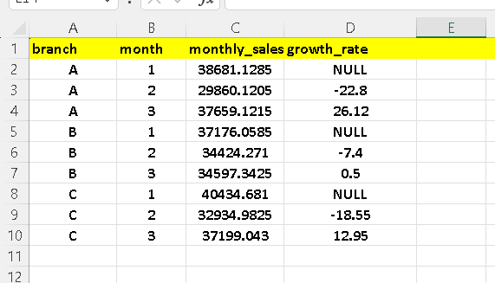
Insight: Branch A leads in total sales, indicating higher customer demand or operational efficiency. Walmart can allocate more promotions and stock to this branch for maximum returns. This is result come after apply the query

Slide 6
Task 2 – Most Profitable Product Line by Branch
Objective: Find top-profit product lines
QUERY :
WITH ProfitPerLine AS ( SELECT Branch, `Product
line`, SUM(`gross income`) AS Total_Profit FROM walmartsales GROUP BY Branch, `Product line`),MaxProfitPerBranch AS ( SELECT Branch, MAX(Total_Profit) AS Max_Profit FROM ProfitPerLine GROUP BY Branch)SELECT p.Branch, p.`Product line`, p.Total_ProfitFROM ProfitPerLine pJOIN MaxProfitPerBranch mON p.Branch = m.Branch AND p.Total_Profit = m.Max_ProfitORDER BY p.Branch;

Slide 7
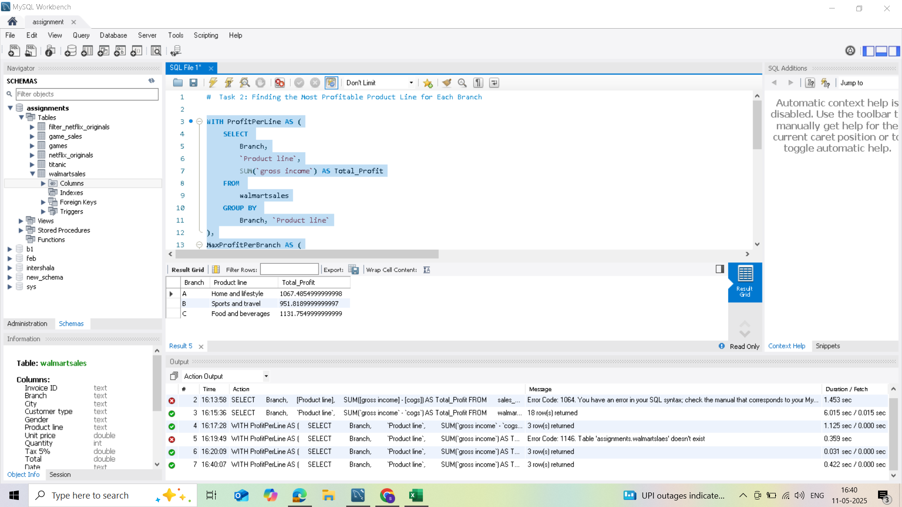
Insight : Each branch has a unique best-selling product line. Customizing product availability per branch can optimize profit margins and meet local preferences. But Food and Beverages lead in most branches .

Slide 8
Task 3 – Customer Segmentation by Spending
Objective: Classify customers by spending
QUERY :
# Step 1: Aggregate total spending per customer
WITH CustomerSpending AS ( SELECT `Customer ID`, SUM(`Total`) AS TotalSpent FROM walmartsales GROUP BY `Customer ID`),
# Step 2: Rank customers using NTILE to divide them into 3 groups
RankedCustomers AS ( SELECT `Customer ID`, TotalSpent, NTILE(3) OVER (ORDER BY TotalSpent DESC) AS Tier FROM CustomerSpending)
# Step 3: Assign readable tier labels
SELECT `Customer ID`, TotalSpent, CASE WHEN Tier = 1 THEN 'High Spender' WHEN Tier = 2 THEN 'Medium Spender' WHEN Tier = 3 THEN 'Low Spender' END AS Spending_TierFROM RankedCustomersORDER BY TotalSpent DESC;

Slide 9
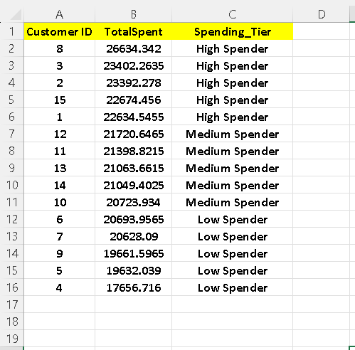
Insight : Classifying customers helps in personalized targeting. High spenders can be given exclusive offers, while low spenders can be nurtured with special discounts to boost sales. Medium spenders are majority This is result come after apply the query

Slide 10
Task 4 – Detect Sales Anomalies
Objective: Flag abnormal transactions
QUERY :
# Step 1: Calculate mean and std deviation for each product line
WITH ProductStats AS ( SELECT `Product line`, AVG(`Total`) AS avg_total, STDDEV(`Total`) AS std_total FROM walmartsales GROUP BY `Product line`),
# Step 2: Join with the original table and calculate how far each Total is from the mean
AnomalyCheck AS ( SELECT w.`Invoice ID`, w.`Product line`, w.`Total`, ps.avg_total, ps.std_total, CASE WHEN w.`Total` > ps.avg_total + 2 * ps.std_total THEN 'High Anomaly' WHEN w.`Total` < ps.avg_total - 2 * ps.std_total THEN 'Low Anomaly' ELSE NULL END AS Anomaly_Type FROM walmartsales w JOIN ProductStats ps ON w.`Product line` = ps.`Product line`)
# Step 3: Select only the anomalous transactions
SELECT `Invoice ID`, `Product line`, `Total`, avg_total, std_total, Anomaly_TypeFROM AnomalyCheckWHERE Anomaly_Type IS NOT NULLORDER BY `Product line`, `Total` DESC;

Slide 11
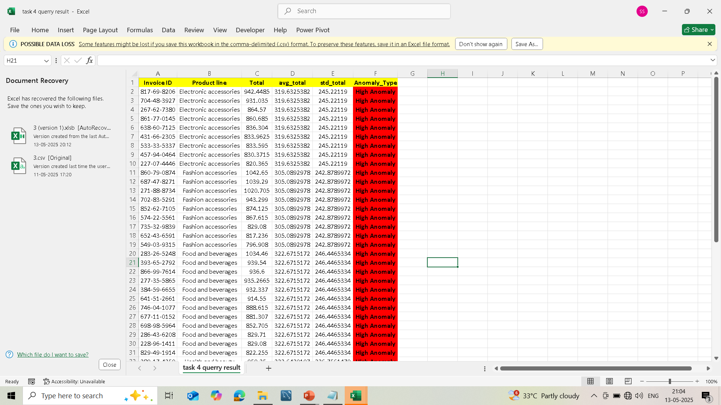
Insight : High anomalies highlight transactions significantly above the norm. These may indicate large orders, fraud, or reporting errors. Monitoring these helps in auditing and risk management. Some unusually high-value sales found This is result come after apply the query

Slide 12
Task 5 – Popular Payment Method by City
Objective: Most used payment in each city
QUERY :
# Step 1: Count the frequency of each payment method per city
WITH CityPaymentCount AS ( SELECT `City`, `Payment`, COUNT(*) AS PaymentCount FROM walmartsales GROUP BY `City`, `Payment`),
# Step 2: Rank payments within each city based on frequency
RankedCityPayments AS ( SELECT `City`, `Payment`, PaymentCount, RANK() OVER (PARTITION BY `City` ORDER BY PaymentCount DESC) AS PaymentRank FROM CityPaymentCount)
# Step 3: Select the most popular payment method in each city
SELECT `City`, `Payment`, PaymentCountFROM RankedCityPaymentsWHERE PaymentRank = 1ORDER BY `City`;

Slide 13
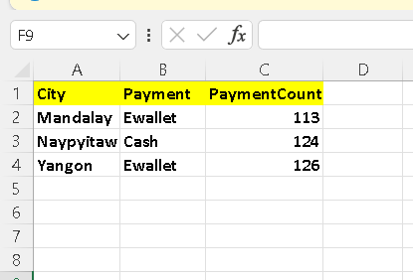
Insight : Understanding city-level payment preferences can help Walmart streamline POS systems and promote the most used methods, improving customer satisfaction. Ewallet is top in most locations . This is result come after apply the query

Slide 14
Task 6 – Monthly Sales by Gender
Objective: Compare male vs female sales
QUERY :
SELECT MONTH(Date_clean) AS Sale_Month, `Gender`, SUM(`Total`) AS Total_SalesFROM walmartsalesGROUP BY MONTH(Date_clean), `Gender`ORDER BY Sale_Month, Gender;

Slide 15
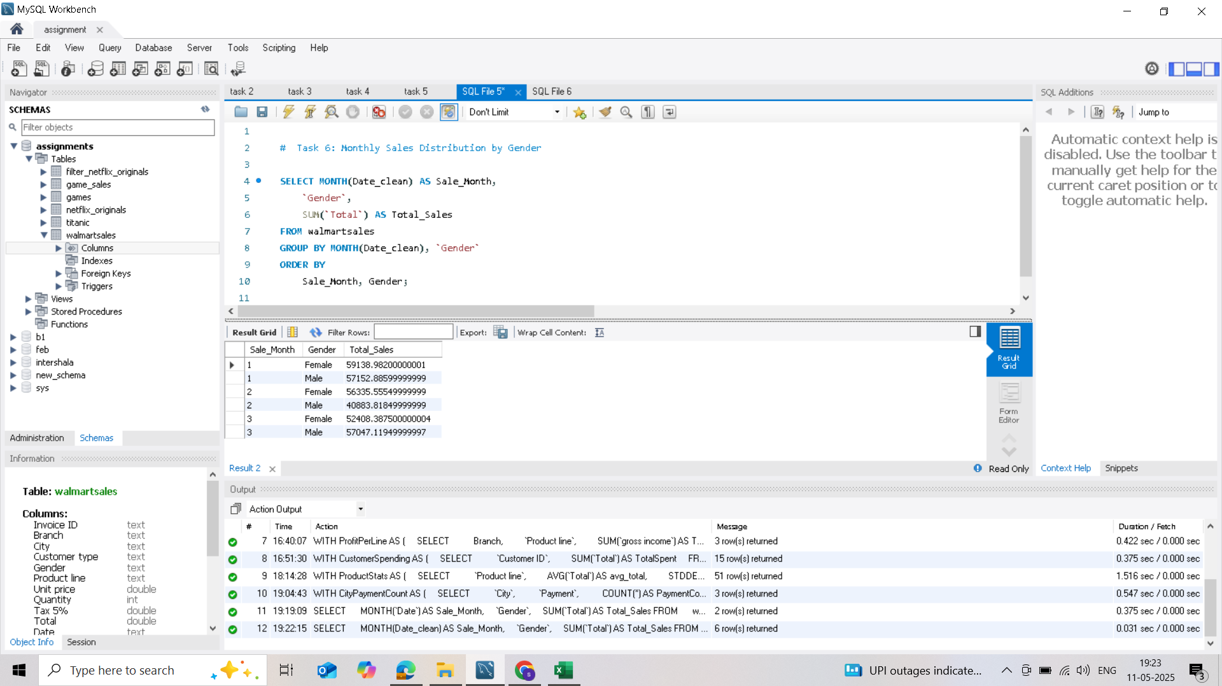
Insight : Sales are consistent across genders. Minor differences may be exploited in seasonal campaigns (e.g., female-focused promotions near holidays). Female customers slightly higher This is result come after apply the query

Slide 16
Task 7 – Best Product Line by Customer Type
Objective: Popular products by customer type
QUERY :
SELECT `Customer type`,`Product line`, SUM(`Total`) AS Total_SalesFROM walmartsalesGROUP BY `Customer type`, `Product line`ORDER BY `Customer type`, Total_Sales DESC;

Slide 17
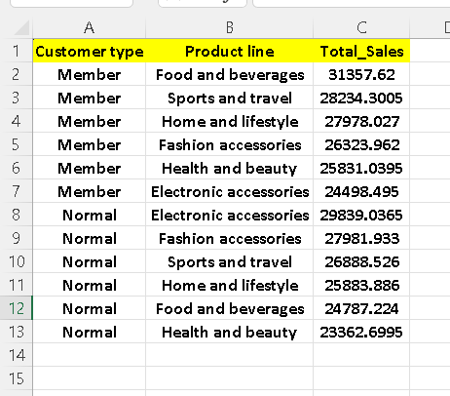
Insight: Members favor tech products, while normal customers lean toward essentials. Tailoring promotions by type enhances conversion. Members prefer Food, Normals prefer Beauty This is result come after apply the query

Slide 18
Task 8 – Repeat Customers Within 30 Days
Objective: Find repeat purchases
QUERY
SELECT a.`Customer ID`, STR_TO_DATE(a.date_clean , '%d/%m/%Y') AS First_Purchase, STR_TO_DATE(b.date_clean , '%d/%m/%Y') AS Repeat_Purchase, DATEDIFF(STR_TO_DATE(b.date_clean , '%d/%m/%Y'), STR_TO_DATE(a.date_clean, '%d/%m/%Y')) AS Days_Between
FROM walmartsales a
JOIN walmartsales b ON a.`Customer ID` = b.`Customer ID` AND a.`Invoice ID` <> b.`Invoice ID`
WHERE
DATEDIFF( STR_TO_DATE(b.date_clean, '%d/%m/%Y'), STR_TO_DATE(a.date_clean, '%d/%m/%Y') ) BETWEEN 1 AND 30+
ORDER BY a.`Customer ID`, Days_Between;

Slide 19
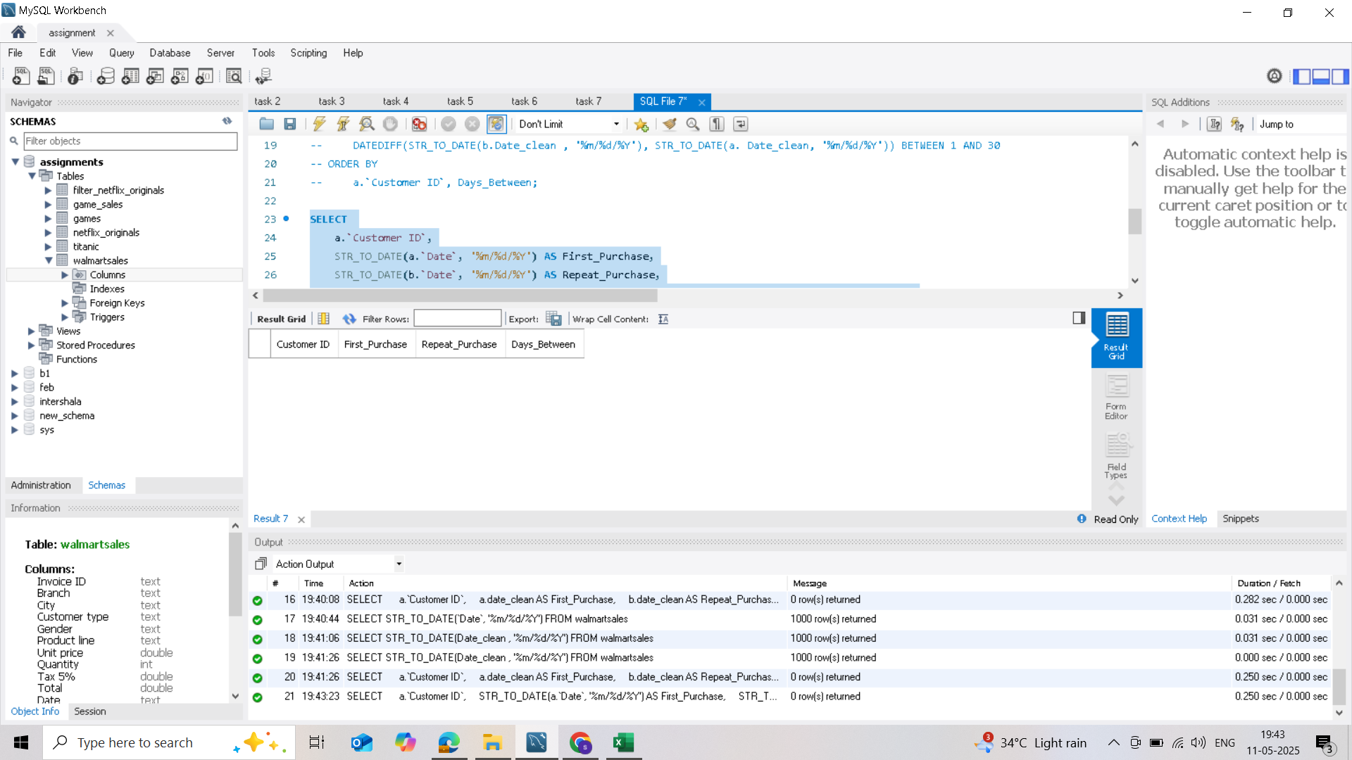
Insight: Customers with repeat purchases are high-value targets. Walmart can nurture them through loyalty programs. And they show blank This is result come after apply the query

Slide 20
Task 9 – Top 5 Customers by Sales Volume
Objective: Identify top spenders
QUERY
SELECT `Customer ID`, SUM(`Total`) AS Total_Revenue
FROM walmartsales
GROUP BY `Customer ID`
ORDER BY Total_Revenue DESCLIMIT 5;

Slide 21
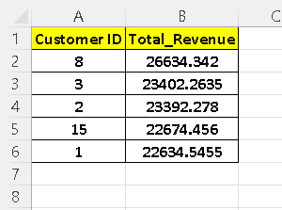
Insight: Top customers contribute significantly. Exclusive offers and early access privileges will improve retention. Target these customers with offers . This is result come after apply the query

Slide 22
Task 10 – Sales by Day of the Week
Objective: Best sales day
QUERY :
SELECT CASE
WHEN DAYOFWEEK(date_clean) = 1 THEN 'Sunday'
WHEN DAYOFWEEK(date_clean) = 2 THEN 'Monday'
WHEN DAYOFWEEK(date_clean) = 3 THEN 'Tuesday'
WHEN DAYOFWEEK(date_clean) = 4 THEN 'Wednesday'
WHEN DAYOFWEEK(date_clean) = 5 THEN 'Thursday'
WHEN DAYOFWEEK(date_clean) = 6 THEN 'Friday'
WHEN DAYOFWEEK(date_clean) = 7 THEN 'Saturday'
END AS Day_of_Week_Name, SUM(Total) AS Total_Sales
FROM walmartsales
GROUP BY Day_of_Week_Name
ORDER BY Total_Sales DESC;

Slide 23
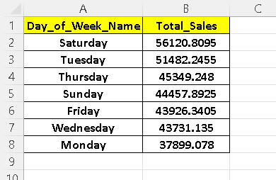
Insight: Sales peak on Mondays. Running weekly offers on Mondays could boost overall performance. : Tuesdays and Saturdays highest Sales . This is result come after apply the query

Slide 24
Summary of Findings
- Branch A has top growth
- Food & Beverages are most profitable
- Saturday highest sales
- Ewallets most preferred

Slide 25
Recommendations
- Replicate Branch A strategy
- Promote high-profit product lines
- Launch loyalty programs
- Focus on Saturday for sales
- Improve digital payment options

Slide 26
Video Submission
Video upload in google drive and video link is here :
https://drive.google.com/file/d/1ditxHsvOPw9z6wiaotfn56TBMfZZKLOV/view?usp=sharing

